Slide 1
Continuous Cardiac Output from Patient Arterial Blood Pressure Readings
Joe and the Joes: Steven Chen, Joe Hakim, Chris Le, and Richard Liu

Slide 2
Overview
Cardiac Output (CO) is a valuable measurement for a variety of diagnostic purposes. However, due to the invasive nature of directly measuring CO, and the limit on the frequency of measurement using thermodilution, creating an estimator that can reliably derive CO from a non-invasive measurements (such as arterial blood pressure) is a worthwhile endeavor. Several estimators have been created compared with each other, with the Liljestrand method being found to be most reliable (Sun et. al 2009).
Our work was similar to that done by Sun and his team in creating and comparing continuous cardiac output plots using different estimators with de-identified patient data.

Slide 3
Code Overview
Part 3
Loaded ABP waveform data and extracted onset time and 2 estimates of end of systole data from the 2analyze functions.
Plotted ABP waveform data for 20 pulses at the 10 hour and 11 hour time points, and superimposed onset time and the end of systole points onto the waveform.
Part 4
Estimated CO using 3 methods and calibrated it using the 1st COtd value from the n file.
Plotted the 3 estimation methods, along with PP, MAP, and HR from the abpfeature.m function

Slide 4
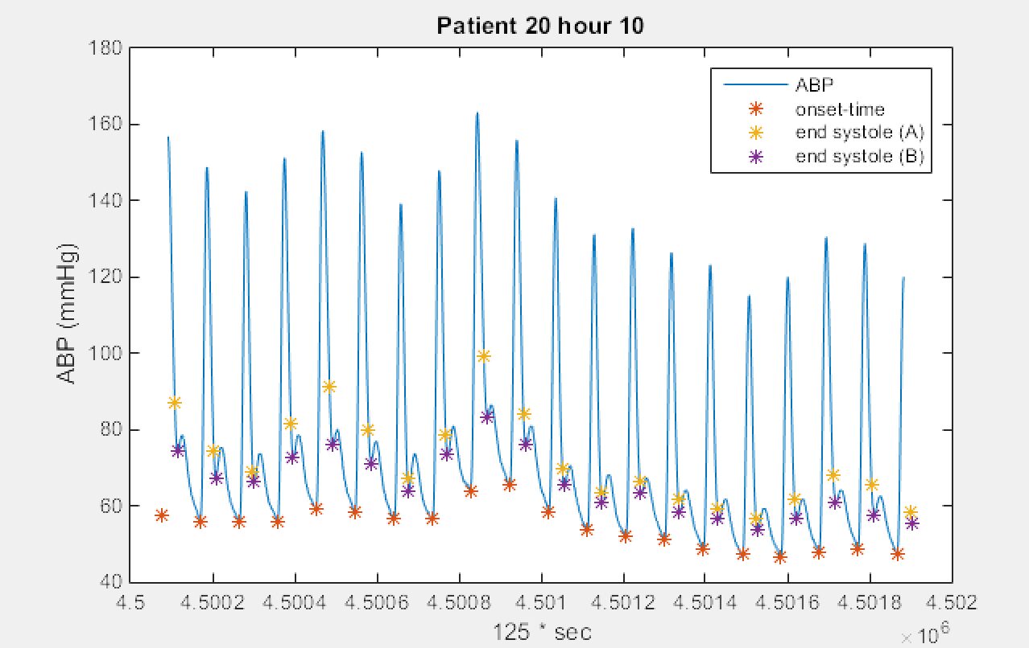
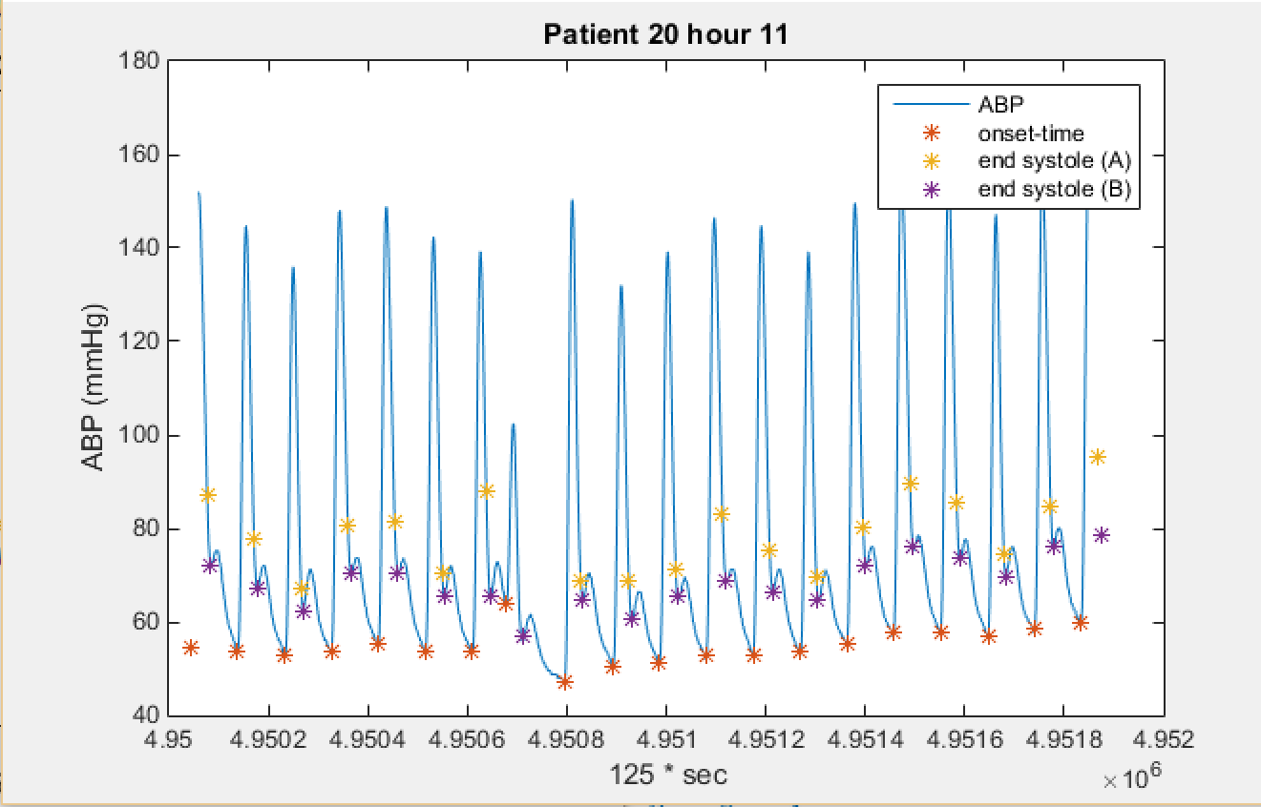
Part 3 Data

Slide 5
Part 3 Qualitative Discussion
First-min-slope method is more consistent in identifying the end of systole, 0.3sqrt(time) varied with wave shape
Systole/Diastole also were identified (not shown), accurately identified
Another patient (1502) had an abnormal waveform, script could not accommodate
Possible improvement: detect when diastolic/systolic pressures alternate with period two, respond by increasing threshold to eliminate dual beats per actual beat

Slide 6
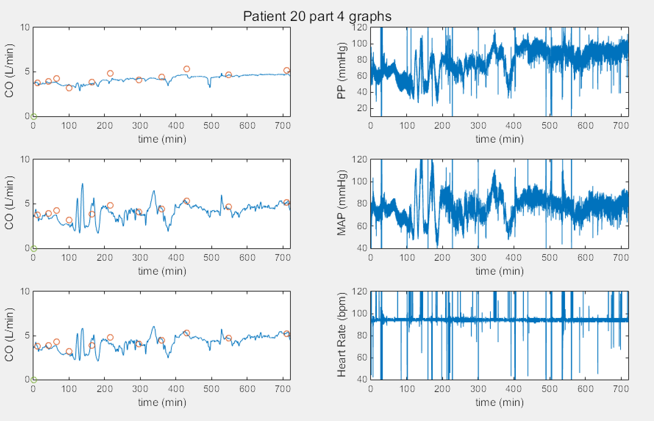
Part 4 data
Notes:
Patient 20, Top left - Method 5 (Liljestrand), Middle left (Method 6- Herd estimator), Bottom left (Method 7 - Wessling systolic area with impedance correction)

Slide 7
Part 4 Qualitative Discussion
In Patient 20, it was found that method 5 was slightly less accurate in predicting the COtd values than methods 6 or 7, however it yielded significantly less fluctuation and noise which makes it very valuable for a continuous estimator.
The heart rate, MAP and PP plots are very noisy and may benefit from filtering like the CO plots.
C1 vs. C2 calibration: C1 was more effective in the end, but since it uses all points, it is less clinically relevant

Slide 8
Code Troubleshooting
Optimal data processing
Most effective strategy was to transfer all data to working memory, and pass that between functions, instead of calling it within functions
Code modularity
Getting the time-scale for different elements of the plots to sync up
Getting consistent Y-scales for the estimators for easy comparison

Slide 9
Project Reflection
Results of this data analysis have a real-world impact
Real data from patients is ugly, code needs to be robust to be able to handle exceptions and unusual waveforms
Occasional spikes leads to scaling issues
Methods are imperfect, so heuristics, subjective judgement becomes necessary for assessment
Data files were large
Instead of rapid, frequent testing, it was necessary to deliberate before running code and loading data
Disagreement with the assessment that estimator 5 was the best
Verification of published results is pretty cool to be able to do, understand assumptions and flaws

